Slide 1



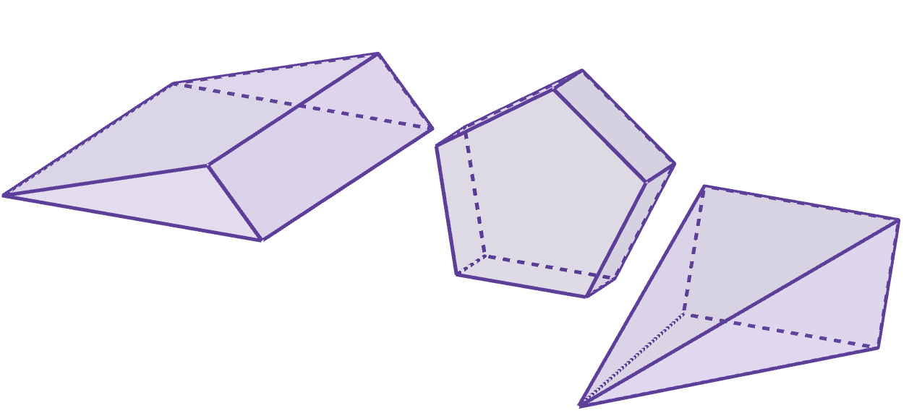
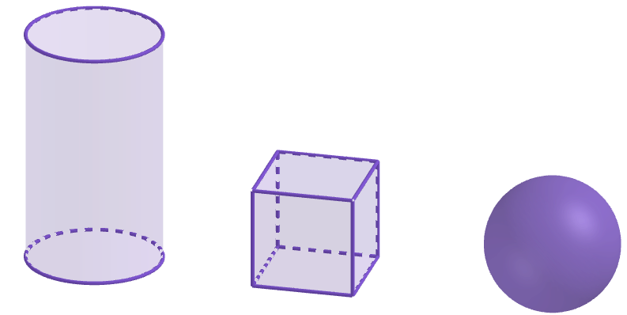
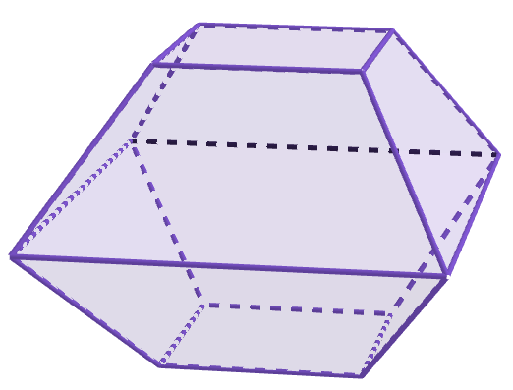
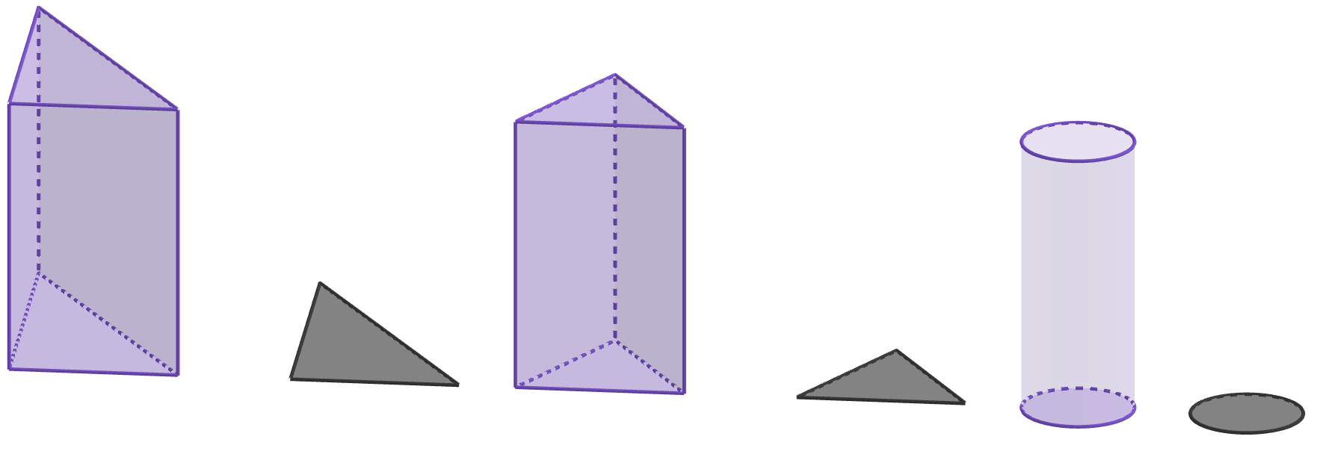
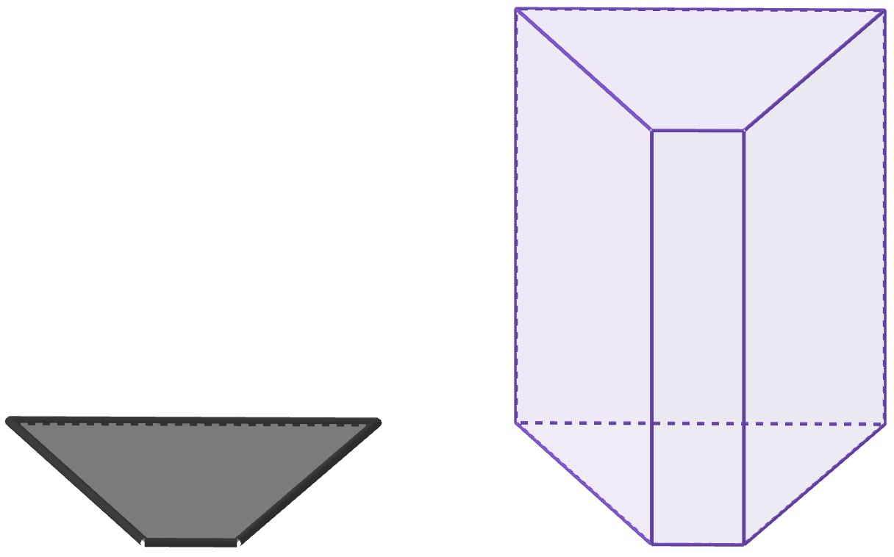
Properties of prisms
Task A: Defining a prism
1) Which of these match the properties of a prism?
a
b
e
f
c
d
g
2) Complete the sentences with the missing words provided to give an explanation of what a prism is.
3D
A prism is a object.
All of its 2D cross sections must be .
In at least one direction, all cross sections must
be to each other.
polygons
parallel
congruent
2D
circular
perpendicular
equidistant
3) These diagrams all show the same prism.
Which of the diagrams show the correct cross sections that help demonstrate it is a prism? Explain how you know.
a
b
c
These cross sections:
are polygons
are parallel to each other
are not congruent
These cross sections:
are polygons
are parallel to each other
are congruent
Therefore, these cross sections help demonstrate this is a prism.
These cross sections:
are polygons
are not parallel to each other
are congruent
Therefore, these cross sections do not help demonstrate this is a prism.
Therefore, these cross sections do not help demonstrate this is a prism.

Slide 2
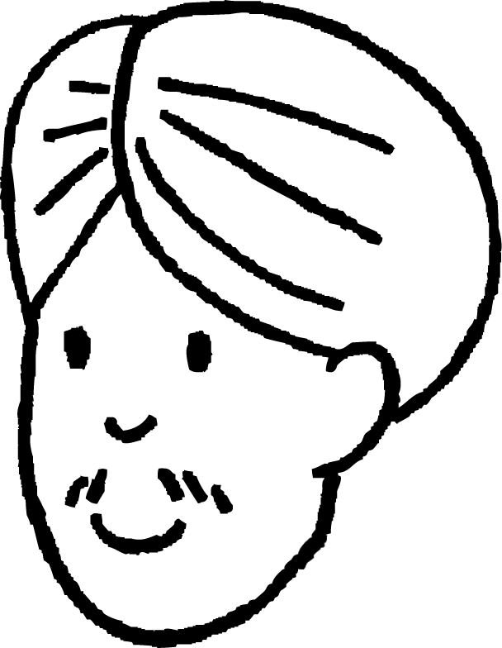
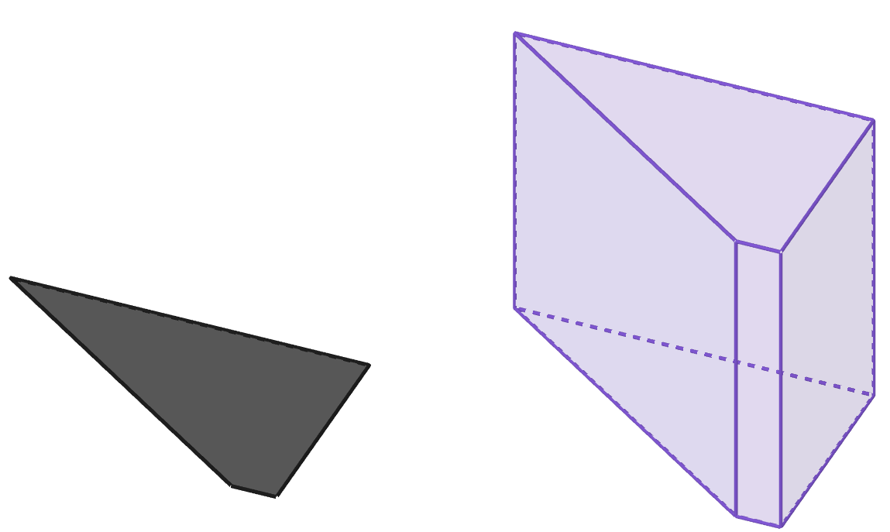
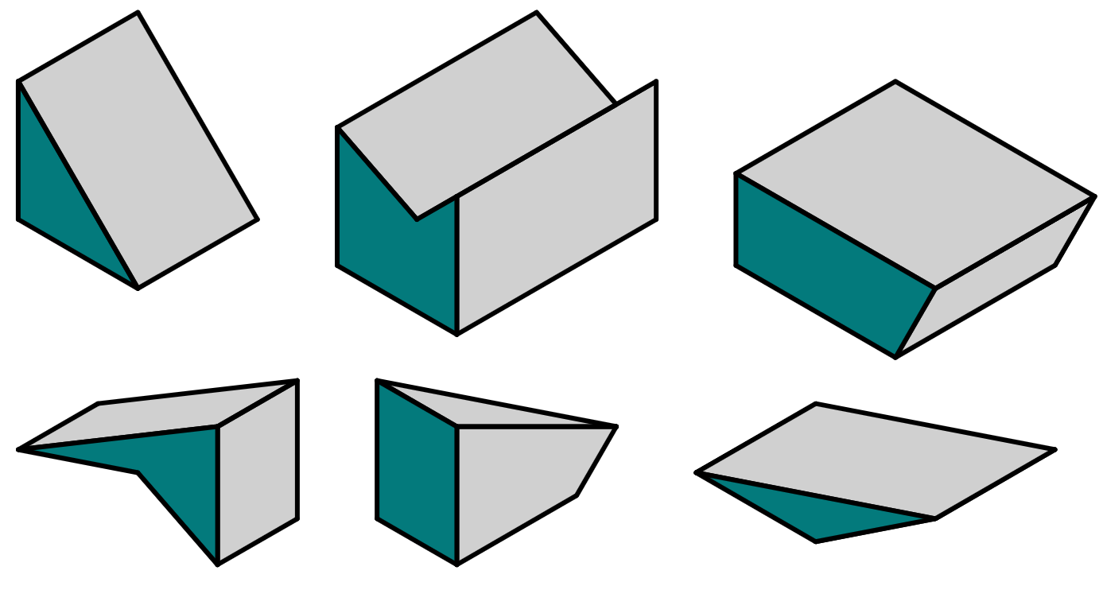
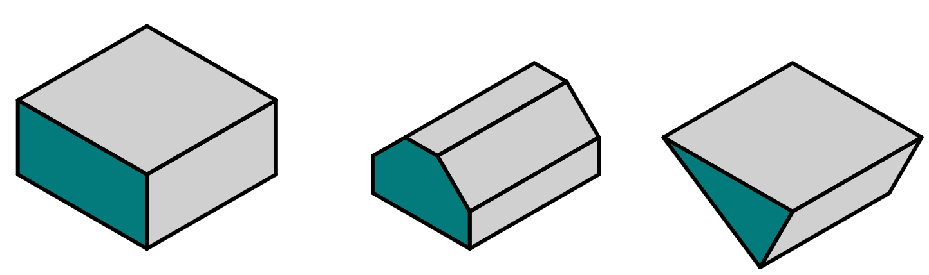
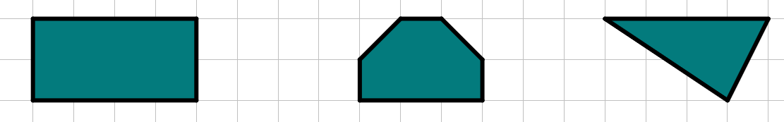
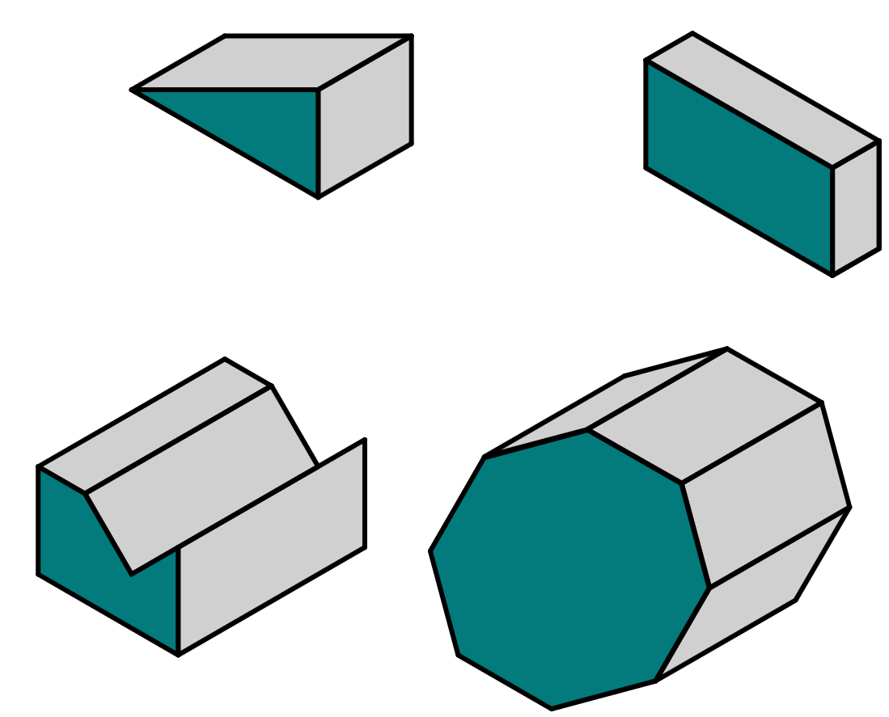

Properties of prisms
4) Andeep says this 3D shape is not a prism, because the two cross sections he found are not congruent to each other. Explain why Andeep is incorrect.
This might still be a prism.
Andeep has not taken two cross sections that are parallel to each other.
One cross section looks parallel to the top face of the object, whilst the other cross section is at an angle compared to the bottom face.
Task B: Categorising prisms
1) Place these 3D shapes into the correct row in the table.
triangular prism
quadrilateral prism
pentagonal prism
not a prism
a
b
a
f
c
c
d
d
e
f
b
e
2) On squared paper, sketch the cross sectional polygon for each of these prisms.
These are only approximate shapes - if your sketch differs slightly, that is okay.
3) Write down a suitable name for each prism.
triangular prism
right-angled triangular prism
a
a
b
b
quadrilateral prism
rectangular prism
e
c
d
c
hexagonal prism
irregular hexagonal prism
d
octagonal prism
regular octagonal prism
If you came up with a different answer, can you justify it?
e
octagonal prism
irregular octagonal prism
Mathematics in Education and Industry.

Slide 3
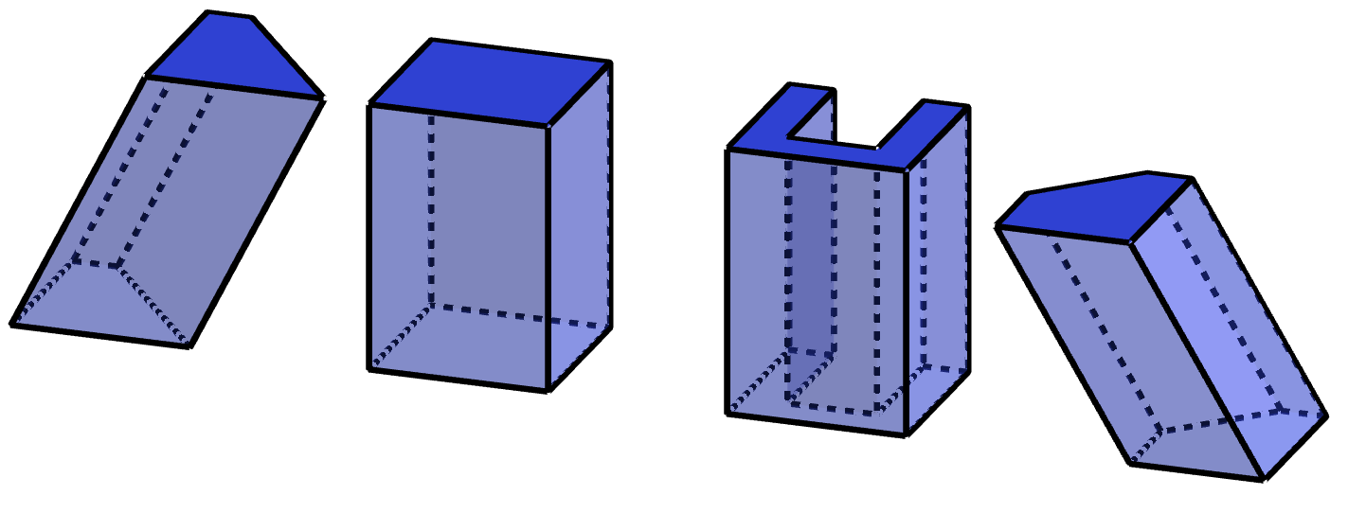

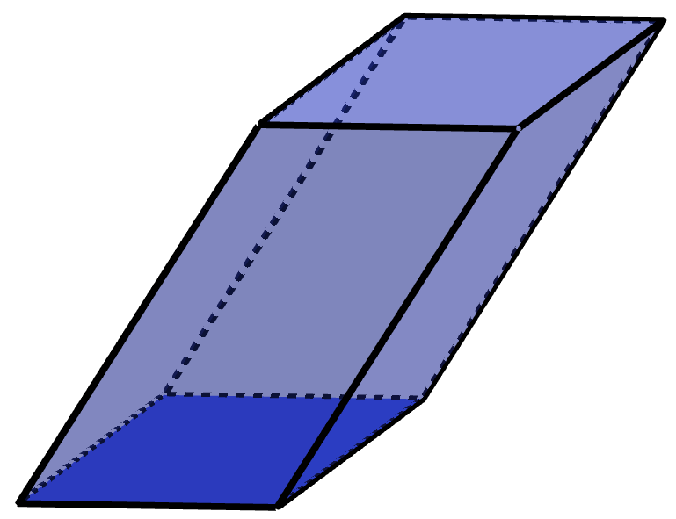
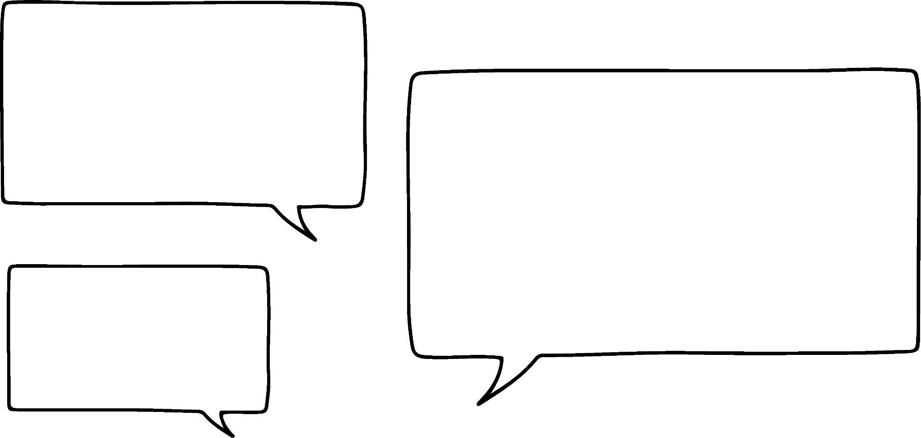
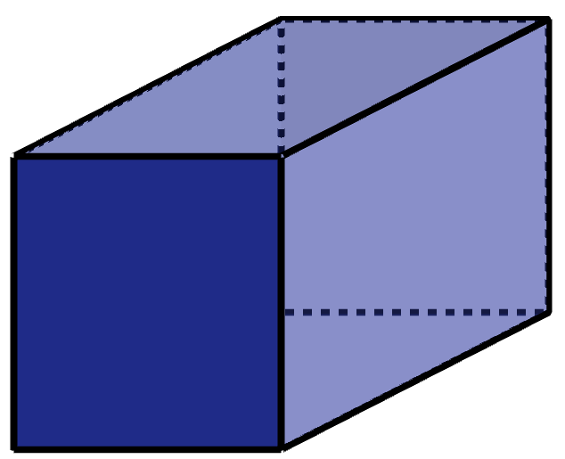

Properties of prisms
Task C: Understanding oblique prisms
1) Place these 3D shapes into the correct row in the table.
c
right prism
oblique prism
d
b
c
a
a
d
b
2) For each prism, write down a suitable name.
a
oblique trapezium prism or oblique quadrilateral prism
b
right rectangular prism or right quadrilateral prism
c
right irregular octagonal prism
d
oblique irregular pentagonal prism
3) Prisms a and b are the same prism seen from different perspectives.
Who is correct: Aisha, Lucas, both, or neither?
a
This prism is an oblique prism.
This is because the rectangles on the top and bottom of prism a are parallel to each other, but the other faces are not perpendicular to them.
Aisha
b
This prism is a right prism.
This is because the parallelograms on the top and bottom of prism b are parallel to each other, and the other faces are perpendicular to them.
Lucas
Both are correct.
This can be true for some quadrilateral prisms.
When looked at in one direction, they are a right parallelogram prism (such as in b).
When looked at in a different direction, they are an oblique rectangular prism (such as in a).
Mathematics in Education and Industry

